Slide 1
User interface design
xkcd

Slide 2
UI Design: Monday Week 11
Dr. Jillian Aurisano
Plan for today:
Announcements/Course logistics
Heuristics
Notes:
So welcome to engineering visual interfaces for data science. I'm Dr Aurisano.
Thanks for finding the class on Zoom. Hopefully we will be in person again soon.
If anyone out there is comfortable turning on their cameras, that is lovely- then I feel like I am talking to students, rather than to myself.
Here’s our plan for today:
First I’m going to introduce myself, so you know a bit about me
Then we are going to get to know each other, in Zoom breakout rooms. This will give us a chance to make sure that Zoom breakout rooms work, and we all know how to access them.
Then, I am going to walk through the structure, and plan for the course. I want to make sure everyone knows how the course will work, and what to expect, and also a bit about why the course is designed this way.
Then I am going to introduce the class, and what the class is about. Since this is a new class, and one of just a few classes in human centered computing here at UC, I wanted to give an overview of the topic.
Then I have an introductory activity, which we will do in breakout rooms, and which I think will help motivate the discussion on Wednesday, and getting into the meat of the class.

Slide 3


Slide 4
I am going to wake up on Wednesday (and Thursday, and Friday…) and try to do good, and so will you. And no one gets to vote on that.

Slide 5
UI for good hackathons
New course material
Hackathon
10 minutes where I introduce the issue
30 minutes of work in teams to ideate and generate ideas
10 minutes of lightning presentations
This week:
Wednesday- UIs to promote donations to an effective charity (against malaria foundation)
Friday- TBD
I will ask teams to submit their in-class work for assignment/participation credit

Slide 6
What is heuristic evaluation?
Heuristic evaluation is an inspection technique for finding usability problems in user interfaces, not unlike doing a code review to find bugs in software.

Slide 7
Heuristics are usability guidelines
Rules that distill out the principles of effective user interfaces.
Help designers choose design alternatives
Help evaluators find problems in interfaces
There are different sets of heuristics to choose from:
Nielsen’s 10 principles
Norman’s rules from Design of Everyday Things
Tognazzini’s 16 principles
Shneiderman’s 8 golden rules
Principles from this class, i.e., learnability, efficiency, and safety.
Notes:
There are plenty of sets of guidelines to choose from - sometimes it seems like every usability researcher has their own set of heuristics. Most of these guidelines overlap in important ways, however. The experts don’t disagree about what constitutes good UI. They just disagree about how to organize what we know into a small set of operational rules.

Slide 8
Heuristics: Who and when?
Who? Usability experts, a.k.a. you
When?
during design, to help you choose among alternative designs;
during heuristic evaluation, to find and justify problems in interfaces

Slide 9
What best describes heuristic evaluation?
Formative evaluation
Summative evaluation
None of the above

Slide 10
Heuristic evaluations are mostly used as a formative evaluation
Heuristic evaluations should be done during the design and development, to quickly find usability issues and address them.
The most suitable kind of summative evaluation is user testing with real users, preferably in real use contexts.

Slide 11
Let’s review the most common heuristics used in the field
Nielsen’s 10 principles
Norman’s rules from Design of Everyday Things
Tognazzini’s 16 principles
Shneiderman’s 8 golden rules

Slide 12
Usability Heuristics
They are not theoretical frameworks.
They are not specific standards.
They are general guidelines evolving out of practice and domain expertise. Nevertheless, most of them can be grounded in theories pertaining to the psychology of human-computer interaction.
Molich, R., & Nielsen, J. (1990). Improving a human-computer dialogue. Communications of the ACM, 33(3), 338-348.
Nielsen, J., & Molich, R. (1990, March). Heuristic evaluation of user interfaces. In Proceedings of the SIGCHI conference on Human factors in computing systems (pp. 249-256). ACM.

Slide 13
Nielsen’s 10 Heuristics
Match the real world (L)
Consistency & standards (L)
Help & documentation (L)
User control & freedom (S)
Visibility of system status (S)
Flexibility & efficiency (E)
Error prevention (S)
Recognition, not recall (S)
Error reporting, diagnosis, and recovery (S)
Aesthetic AND minimalist design
Read more:
https://www.nngroup.com/articles/ten-usability-heuristics/
Notes:
https://www.nngroup.com/articles/ten-usability-heuristics/

Slide 14
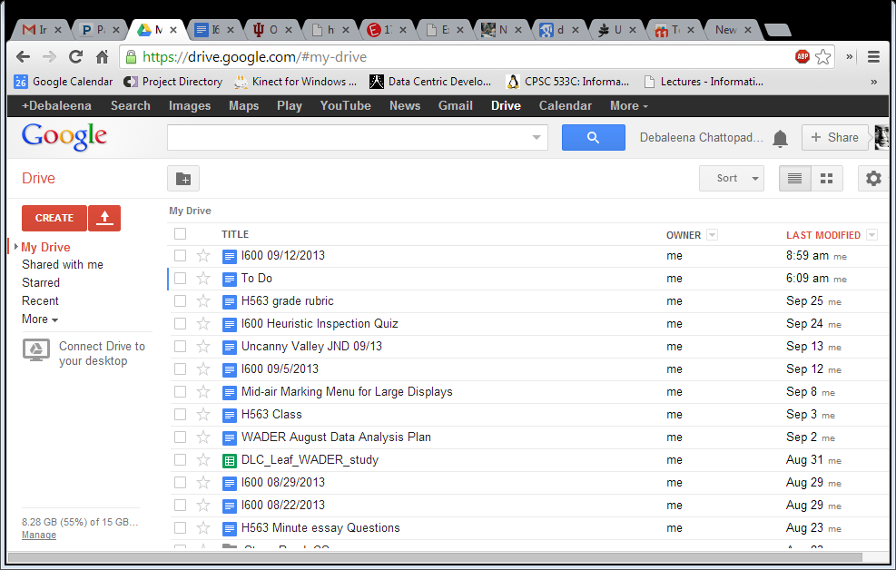
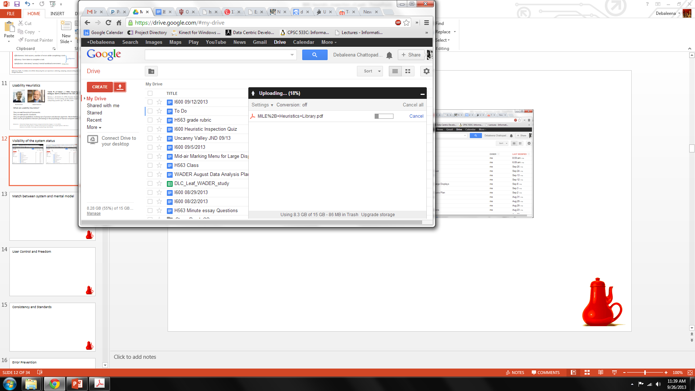
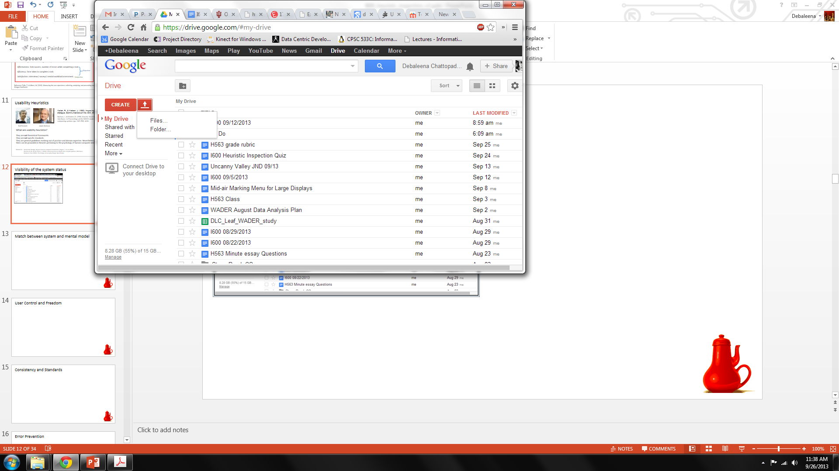
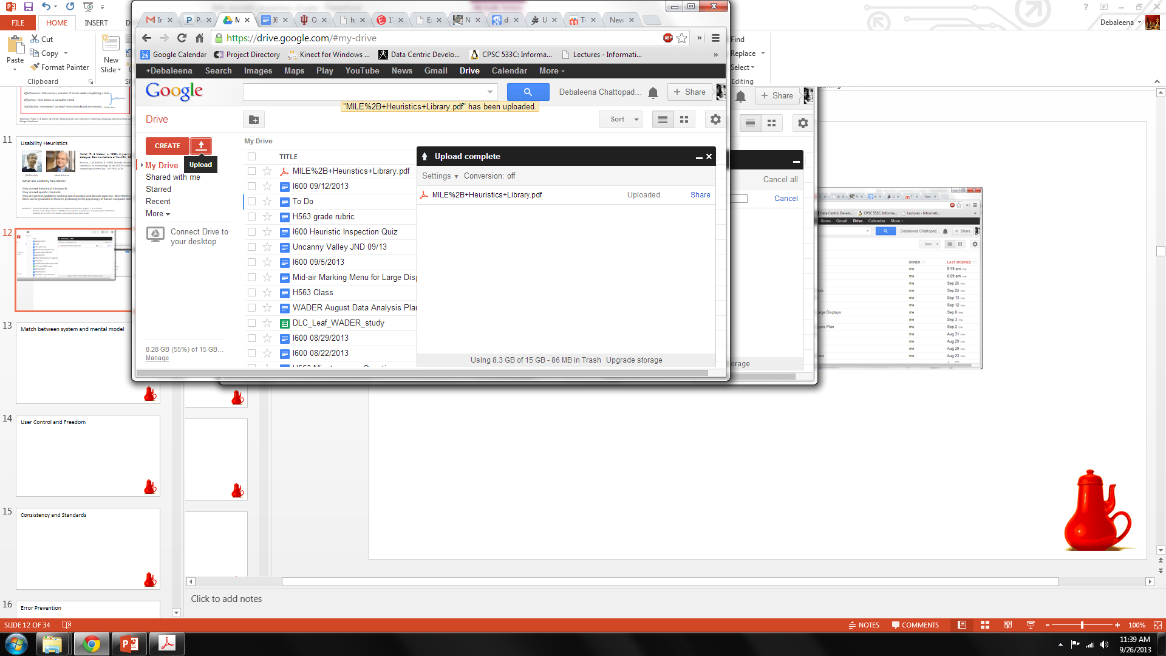
Visibility of the system status
1
3
2
4
Notes:
The design should always keep users informed about what is going on, through appropriate feedback within a reasonable amount of time.

Slide 15
Match between system and the real world
Notes:
The design should speak the users' language. Use words, phrases, and concepts familiar to the user, rather than internal jargon. Follow real-world conventions, making information appear in a natural and logical order.

Slide 16
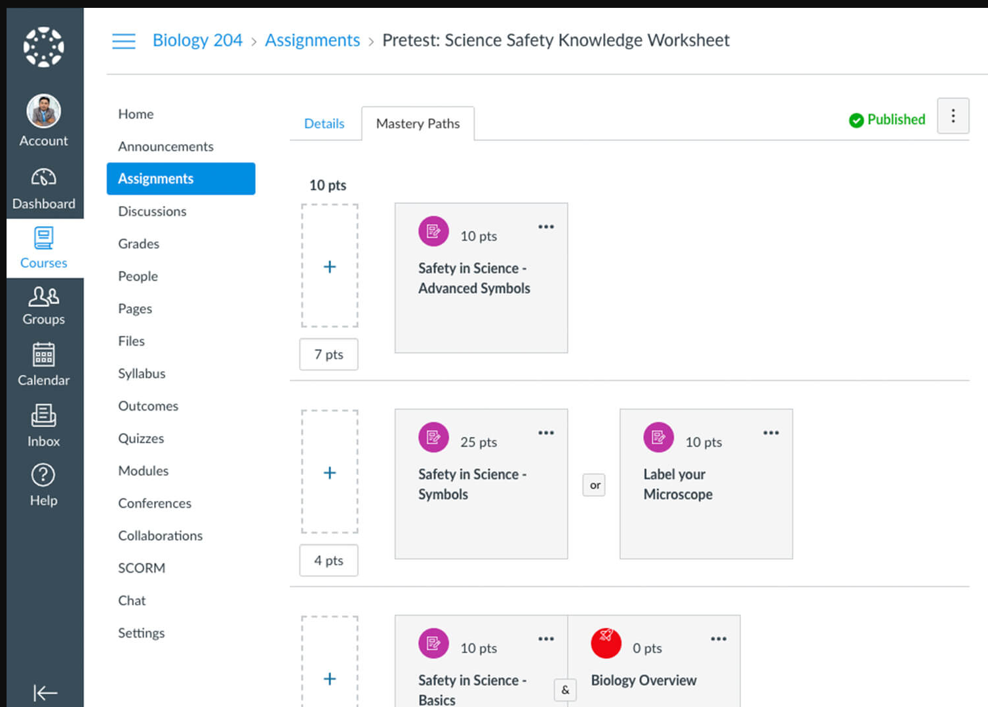
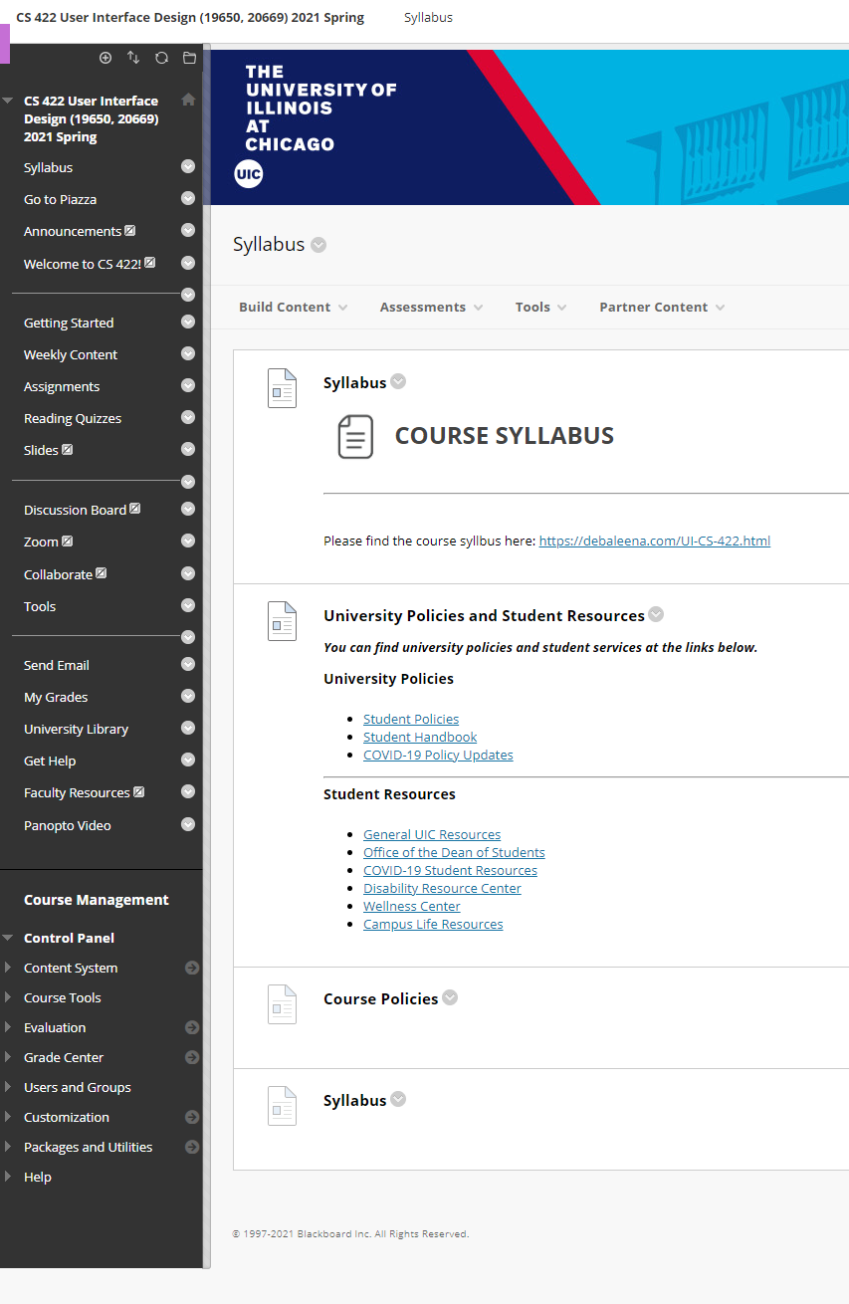
Match between system and mental model
Notes:
The system should speak the users' language, with words, phrases and concepts familiar to the user, rather than system-oriented terms.
Follow real-world conventions, making information appear in a natural and logical order.

Slide 17
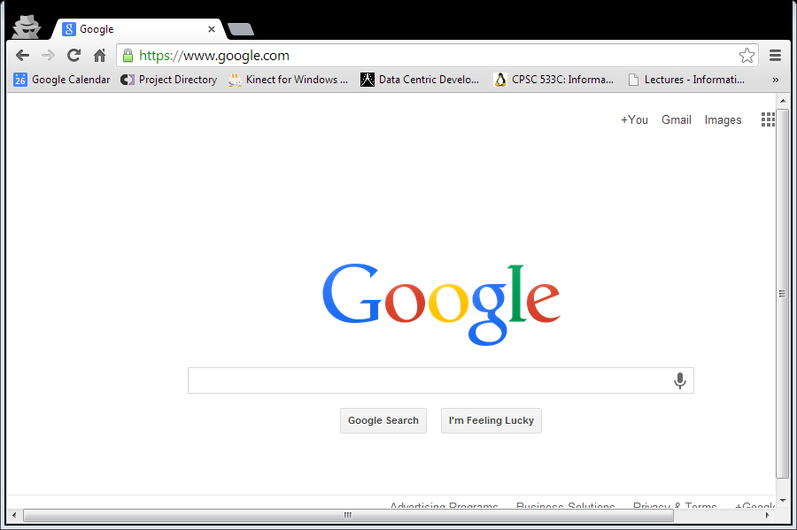
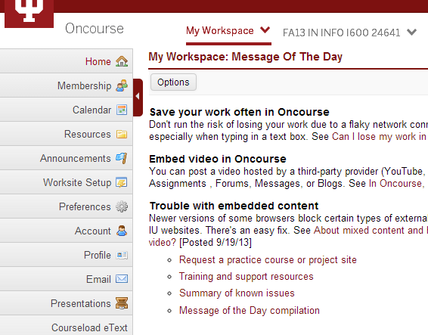

User Control and Freedom
Notes:
Users often perform actions by mistake. They need a clearly marked "emergency exit" to leave the unwanted action without having to go through an extended process.

Slide 18
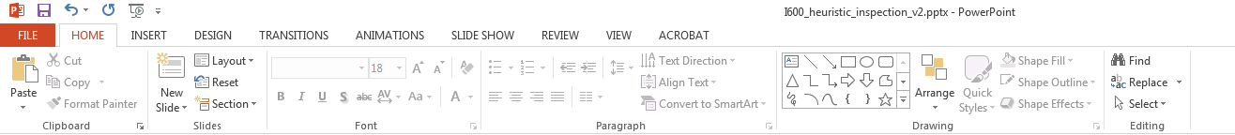
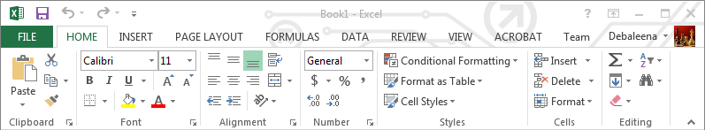

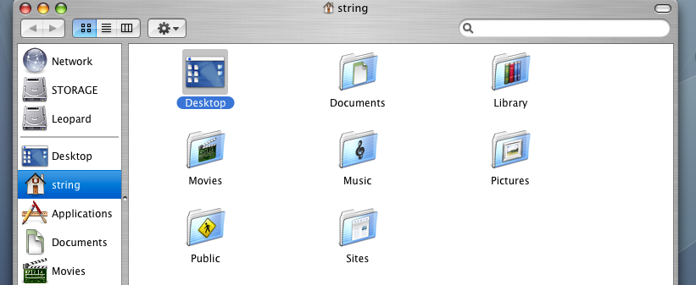
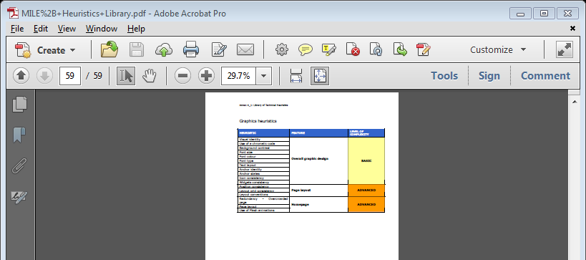
Consistency and Standards
Notes:
Users should not have to wonder whether different words, situations, or actions mean the same thing. Follow platform and industry conventions.

Slide 19

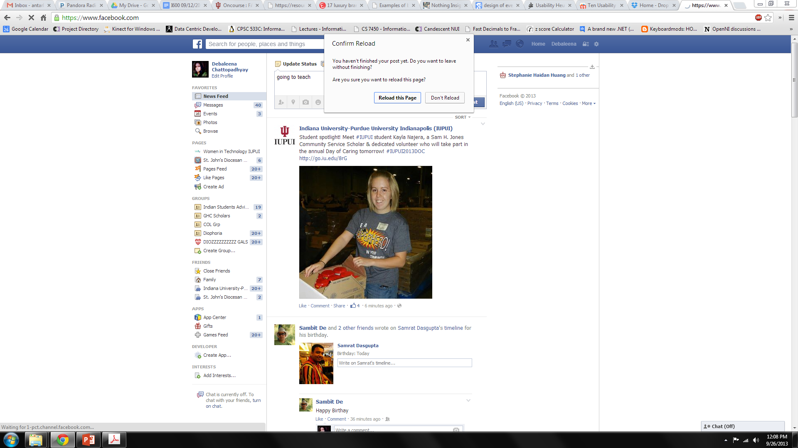
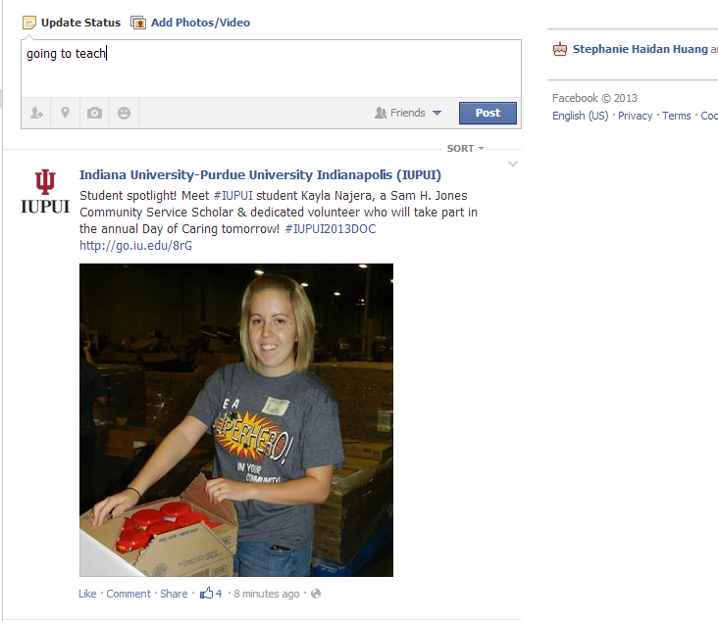
Error Prevention
Notes:
Good error messages are important, but the best designs carefully prevent problems from occurring in the first place. Either eliminate error-prone conditions, or check for them and present users with a confirmation option before they commit to the action.

Slide 20
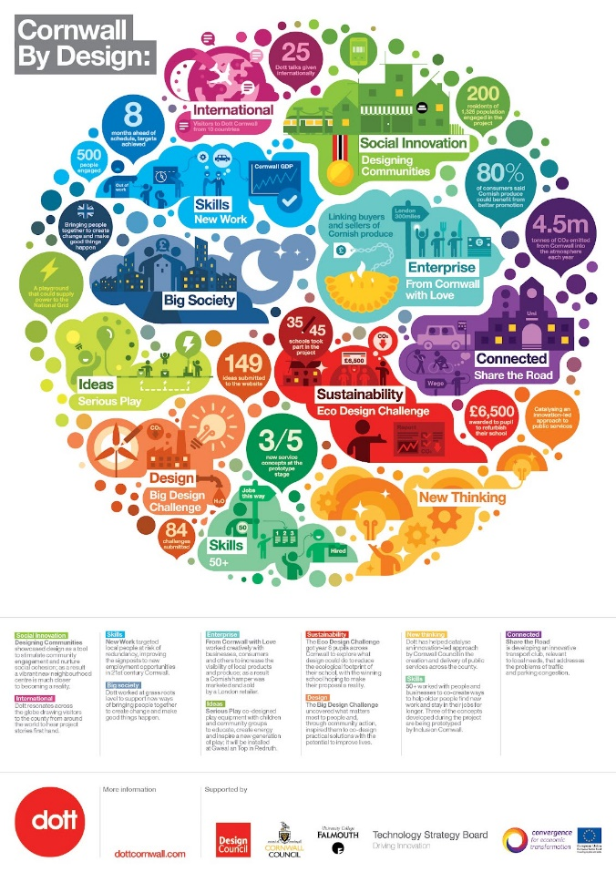
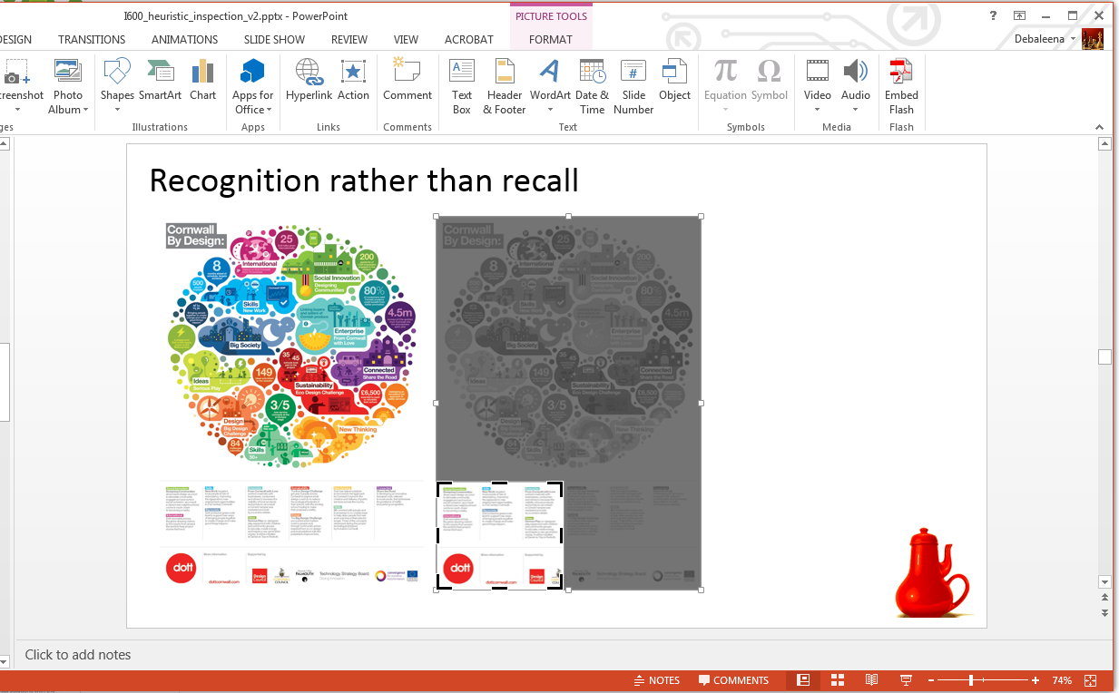
Recognition rather than recall
Making actions visible
Notes:
Minimize the user's memory load by making elements, actions, and options visible. The user should not have to remember information from one part of the interface to another. Information required to use the design (e.g. field labels or menu items) should be visible or easily retrievable when needed.

Slide 21
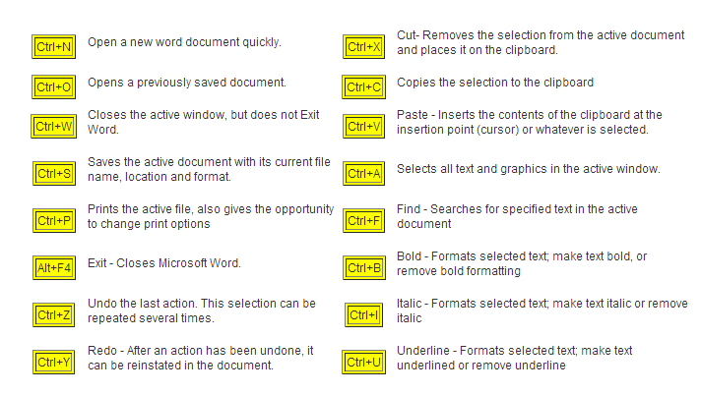
Flexibility and efficiency of use
The ribbon menu
Keyboard shortcuts
Notes:
Shortcuts — hidden from novice users — may speed up the interaction for the expert user such that the design can cater to both inexperienced and experienced users. Allow users to tailor frequent actions.

Slide 22
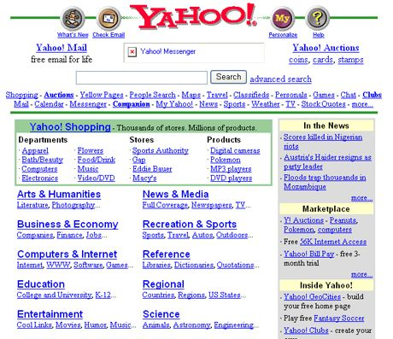
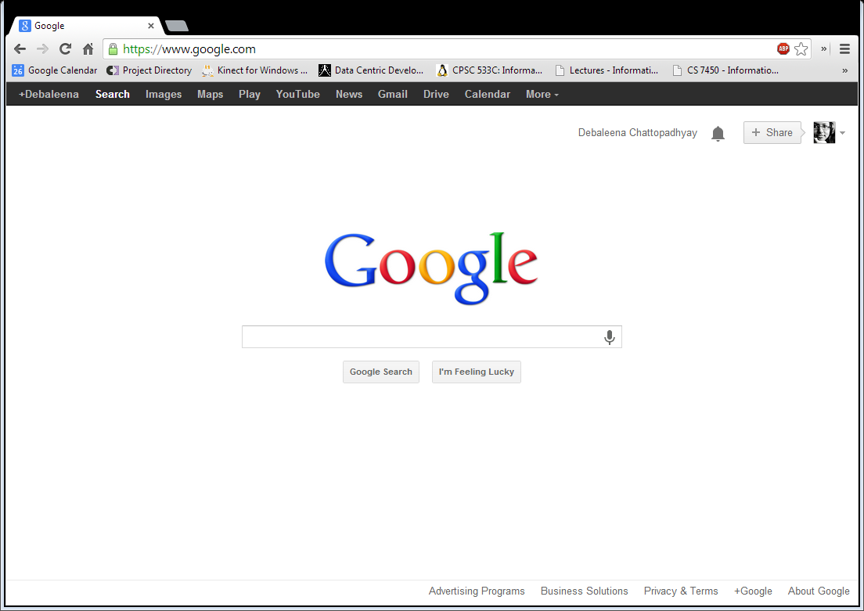
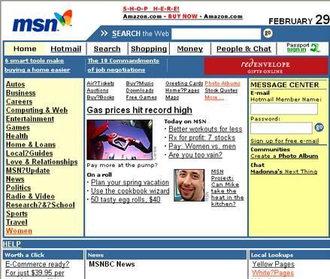
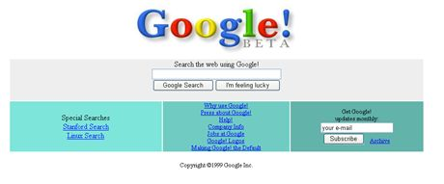
Aesthetic and minimalist design
Notes:
Interfaces should not contain information which is irrelevant or rarely needed. Every extra unit of information in an interface competes with the relevant units of information and diminishes their relative visibility.

Slide 23
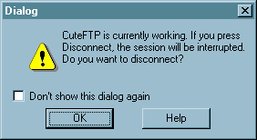
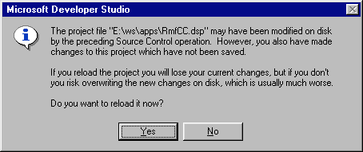
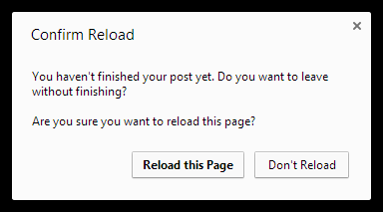
Help users recognize, diagnose, and recover from errors
Notes:
Error messages should be expressed in plain language (no error codes), precisely indicate the problem, and constructively suggest a solution.

Slide 24
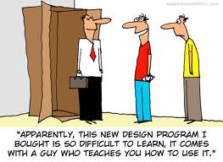
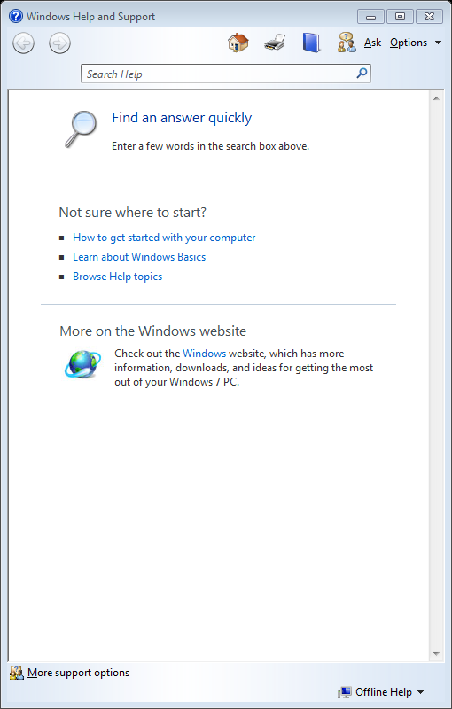
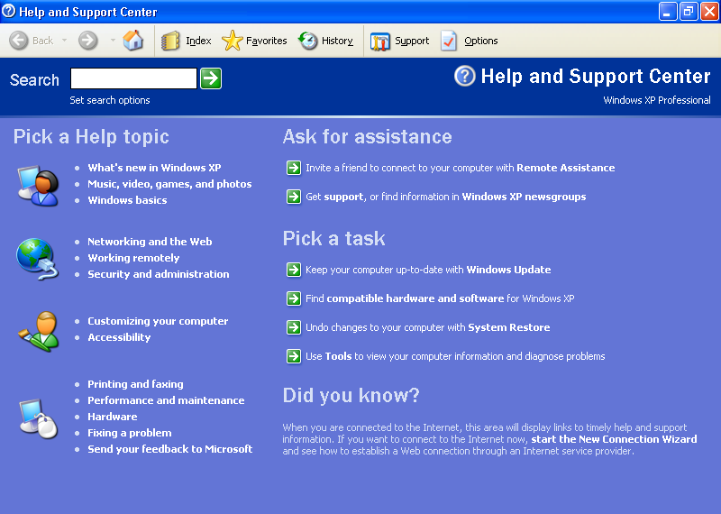
Help and Documentation
Windows 7
Windows XP
Notes:
It’s best if the system doesn’t need any additional explanation. However, it may be necessary to provide documentation to help users understand how to complete their tasks.

Slide 25
Nielsen’s 10 Heuristics
Match the real world (L)
Consistency & standards (L)
Help & documentation (L)
User control & freedom (S)
Visibility of system status (S)
Flexibility & efficiency (E)
Error prevention (S)
Recognition, not recall (S)
Error reporting, diagnosis, and recovery (S)
Aesthetic AND minimalist design

Slide 26
Norman Principles
Affordances
Natural mapping (mapping between the user and system model)
Visibility
Feedback

Slide 27
Tog’s First Principles
Anticipation
Autonomy
Color blindness
Consistency
Defaults
Efficiency
Explorable interfaces
Fitts’s Law
Human interface objects
Latency reduction
Learnability
Metaphors
Protect users’ work
Readability
Track state
Visible navigation
Notes:
Autonomy means user is in control.
Human interface objects is another way of saying direct manipulation
Latency reduction means minimize response time and give appropriate feedback for slow operations.

Slide 28
Shneiderman’s 8 Golden Rules
Consistency
Shortcuts
Feedback
Dialog closure
Simple error handling
Reversible actions
Put user in control
Reduce short-term memory load

Slide 29
Heuristic Evaluation: The Process
Performed by an expert
Steps
Inspect UI thoroughly
Compare UI against heuristics
List usability problems
Explain & justify each problem with heuristics

Slide 30
How To Do Heuristic Evaluation
Justify every problem with a heuristic
“Too many choices on the homepage (Aesthetic & Minimalist Design)”
Can’t just say “I don’t like the colors”
List every problem
Even if an interface element has multiple problems
Go through the interface at least twice
Once to get the feel of the system
Again to focus on particular interface elements
Don’t have to limit to the 10 Nielsen heuristics
Nielsen’s 10 heuristics are easier to compare against
Our 3 general principles are easier still

Slide 31
What is the main difference between heuristic evaluation and user testing?
Assessing usability
Real users testing the UI
All of the above

Slide 32
What is the main difference between heuristic evaluation and user testing?
Assessing usability
Real users testing the UI
All of the above
Evaluator is not the user!

Slide 33
Heuristic Evaluation Is Not User Testing
Evaluator is not the user either
Maybe closer to being a typical user than you are, though
Analogy: code inspection vs. testing
HE finds problems that UT often misses
Inconsistent fonts
Fitts’s Law problems
But UT is the gold standard for usability

Slide 34
Hints for Better Heuristic Evaluation
Use multiple evaluators
Different evaluators find different problems
The more the better, but diminishing returns
Nielsen recommends 3-5 evaluators
Alternate heuristic evaluation with user testing
Each method finds different problems
Heuristic evaluation is cheaper
It’s OK for observer to help evaluator
As long as the problem has already been noted
This wouldn’t be OK in a user test

Slide 35
Formal Evaluation Process
Training
Meeting for design team & evaluators
Introduce application
Explain user population, domain, scenarios
Evaluation
Evaluators work separately
Generate written report, or oral comments recorded by an observer
Focus on generating problems, not on ranking their severity yet
1-2 hours per evaluator
Severity Rating
Evaluators prioritize all problems found (not just their own)
Take the mean of the evaluators’ ratings
Debriefing
Evaluators & design team discuss results, brainstorm solutions

Slide 36
Severity Ratings
Not all usability problems are equal.
It helps to think about the factors that contribute to the severity of a problem:
its frequency of occurrence (common or rare);
its impact on users (easy or hard to overcome), and
its persistence (does it need to be overcome once or repeatedly).
A problem that scores highly on several contributing factors should be rated more severe than another problem that isn’t so common, hard to overcome, or persistent.

Slide 37
Severity Ratings
Contributing factors
Frequency: how common?
Impact: how hard to overcome?
Persistence: how often to overcome?
Severity scale
Cosmetic: need not be fixed
Minor: needs fixing but low priority
Major: needs fixing and high priority
Catastrophic: imperative to fix

Slide 38
Evaluating Prototypes
Heuristic evaluation works on:
Sketches
Paper prototypes
Buggy implementations
“Missing-element” problems are harder to find on sketches
Because you’re not actually using the interface, you aren’t blocked by feature’s absence
Look harder for them
Notes:
When you’re just inspecting a sketch, you’re less likely to notice missing elements, like buttons or features essential to proceeding in a task. If you were actually interacting with an active prototype, essential missing pieces rear up as obstacles that prevent you from proceeding.

Slide 39
Writing Good Heuristic Evaluations
Heuristic evaluations must communicate well to developers and managers
Include positive comments as well as criticisms
“Good: Toolbar icons are simple, with good contrast and few colors (minimalist design)”
Be tactful
Not: “the menu organization is a complete mess”
Better: “menus are not organized by function”
Be specific
Not: “text is unreadable”
Better: “text is too small, and has poor contrast (black text on dark green background)”

Slide 40
Suggested Report Format
Include the following:
Problem
Heuristic
Description
Severity
Recommendation (if any)
Screenshot (if helpful)

Slide 41
Cognitive Walkthrough: Another Inspection Technique
Another expert technique
Unlike heuristic evaluation, which is general, a cognitive walkthrough is particularly focused on evaluating learnability - determining whether an interface supports learning how to do a task by exploration.
A cognitive walkthrough also needs an explicit sequence of actions, the path, that would perform each task.
The overall goal of the process is to determine whether this is an easy path for users to discover on their own.
Heuristic evaluation→ individual elements in the interface; cognitive walkthrough → individual actions in achieving a goal, focusing on learnability.

Slide 42
If learnability is very important in your application
Cognitive walkthrough is a more specialized inspection technique than heuristic evaluation, but if learnability is very important in your application, then a cognitive walkthrough can produce very detailed, useful feedback, very cheaply.
Common questions explored:
Will user try to achieve the right subgoal?
Will the user find the action in the interface?
Will the user recognize that the action accomplishes their subgoal?
If the correct action was done, will the user understand its feedback?

Slide 43
In your project groups
Use the heuristic evaluation pdf’s
Choose one to focus on
Consider it for your UI
Write a brief report on the heuristic eval criteria and your UI

Slide 44
Slide credits
Debaleena Chattopadhyay

